Slide 1

SUMMER SWIM SEASON

Slide 2
Introductions - Board
Erik Frandsen: President
Jessi Gaal: Vice-President, Parent Delegate
Nicole Wilson: Treasurer
Wendy Sivertsen: Communications / Registration
Laura Strom: Volunteer Coordinator

Slide 3
Coaches
Head Coach: Jill Milla
Assistant Coaches: Emma Poole, Cole Frandsen, and Harper Sivertsen
Junior Coaches: TBD – Ages 14-18
Interested in being an junior coach?
Submit to canterberryswimteam@gmail.com:
A summary answering, “Why I think I would be an awesome swim coach!”

Slide 4
Croc's – Who are We
The Crocs are a volunteer-run, non-profit organization.
Our mission is to foster a supportive swim community where children learn the four primary swim strokes, while building a culture of sportsmanship, teamwork, and respect.
We aim to provide opportunities to develop lasting memories and relationships in an inclusive and welcoming environment.

Slide 5
Who can be on the team?
Any individual ages 4-18 that live in the Canterberry Crossing community.
Age groups are: 6U, 8U, 9-10, 11-12, 13-14, 15-18
Swimmers are seeded based on their age as of June 1.
Girls and boys compete separately, without direct competition against each other.
To qualify for an award in a swim meet, swimmers must swim the full 25 meters unassisted.
If your swimmer is still learning individual strokes, they can still participate! Through daily practices, the coaching team will work with your swimmer on learning the strokes and swimming them legally in a meet.
If your swimmer has never swam on a team before, the Crocs are a great way to get started!

Slide 6
What is the commitment? (Practices)
Canterberry Crocs have practice options 5 days a week:
Practice Times:
Mondays, Wednesdays, and Thursdays:
Ages 11 & Under: 8:00pm – 8:45pm
Ages 12 and Up: 8:45pm – 9:30pm
Tuesdays:
Ages 11 & Under: 6:30am – 7:30am
Ages 12 and Up: 7:30am – 8:30am
Friday:
Entire Team: 7:30am – 8:30am
Practices are held at the Canterberry Pool.
First practice is Tuesday, May 27.
Coaching staff asks swimmers attend a minimum of 3 practices a week.

Slide 7
What is the commitment? (Meets)
The Canterberry Crocs Swim Team is part of the Mountain High Swim League.
There are 23 teams in the South Metro/Castle Rock Area
The teams are broken into 4 divisions A-D. Canterberry Crocs are currently in Division B.
Division B currently includes the following teams:
Canterberry Crocs
Wildcat Ridge Tiger Sharks
Holly Park Sharks
Southglenn Country Club Gators
Piney Creek Heat
Castle Pines Crocs
Meets are on Saturday mornings.
Dual Meet dates: 5/31, 6/7, 6/14, 6/21, 6/28
Championships: 7/8-7/9 (Prelims), 7/12 (Finals)
All-Stars: 7/19
Meets typically last from 6:30am (warm-ups) to 2pm (last relay).

Slide 8
2025 Meets
Saturday, May 31 - Piney Creek (Away, 8-lane Meters) 5852 S Joplin Way, Centennial, CO 80015
Saturday, June 7 - Castle Pines (Away, 6-lane Meters) 7306 Oxford Dr, Castle Pines, CO 80108
Saturday, June 14 - @ MACS Pool (hosted by Canterberry) versus Wildcat Ridge 3869 S Atchison Way, Aurora CO 80014
Saturday, June 21 - @ MACS Pool (hosted by Canterberry) versus Southglenn 3869 S Atchison Way, Aurora CO 80014
Saturday, June 28 - @ MACS Pool (hosted by Canterberry) versus Holly Park 3869 S Atchison Way, Aurora CO 80014
Tuesday, July 8 - PRELIMS, 9/10 & 11/12 - Wildcat Ridge (Away, 6-lane Meters) 10511 Serengeti Dr, Lone Tree, CO 80124
Wednesday, July 9 - PRELIMS, 8U & 13+ - Castle Pines (Away, 6-lane Meters) 7306 Oxford Dr, Castle Pines, CO 80108
Saturday, July 12 - Championships - Piney Creek (Away, 8-lane Meters) 5852 S Joplin Way, Centennial, CO 80015
Saturday, July 19 - Allstars TBD

Slide 9
What is the commitment? (Parents)
Our swim team is run by ALL parents on the team.
Every family is expected to volunteer time during meets, organizing events, etc.
To ensure that everyone participates, the team requires a ‘volunteer deposit’ from each family. The deposit will be RETURNED if volunteer requirements are met.
Minimum of 4 volunteer shifts per family.
Additional volunteer shifts are required for those swimming at Prelims, Championships, and/or All-Stars
Volunteer deposit = $200 check per family.
Opportunities to volunteer during meets:
* Further information about each role is available on the Crocs Website or ask a Crocs returning family. No experience needed.
Officials: Stroke & Turn, Starter, Deck Ref and Meet Ref require additional training, which is provided free by the League.
If interested, please talk to Jessi Gaal or Erik Frandsen or email the Crocs at canterberryswimteam@gmail.com
Runner Stroke & Turn Timing Scoring | Clerk of Course Concessions Heating Meet Setup

Slide 10
Fees and other expenses
2025 Registration Fees
$210 1st swimmer
$195 2nd swimmer
$180 each additional swimmer
What do the fees cover?
Coaching staff
Pool usage, lifeguards and insurance for all practices and all meets. (including Championships/All-Stars).
Individual Awards throughout the season and for Championships.
Team Shirt
Team sponsored events including Team and Individual Pictures, season-end Banquet, Team building activities, and Donut Friday.
What else should I expect?
$50(f) / $35(m) – Team swimsuit (required)
Other equipment at your discretion: swim caps, goggles, etc.
Venmo or Cash for snacks at meets

Slide 11
SPIRIT NIGHTS
MOD PIZZA - Tuesday, May 20 – open to close. They will donate 25% of sales if you mention "Canterberry Swim Team".
More to be announced on Social Media

Slide 12
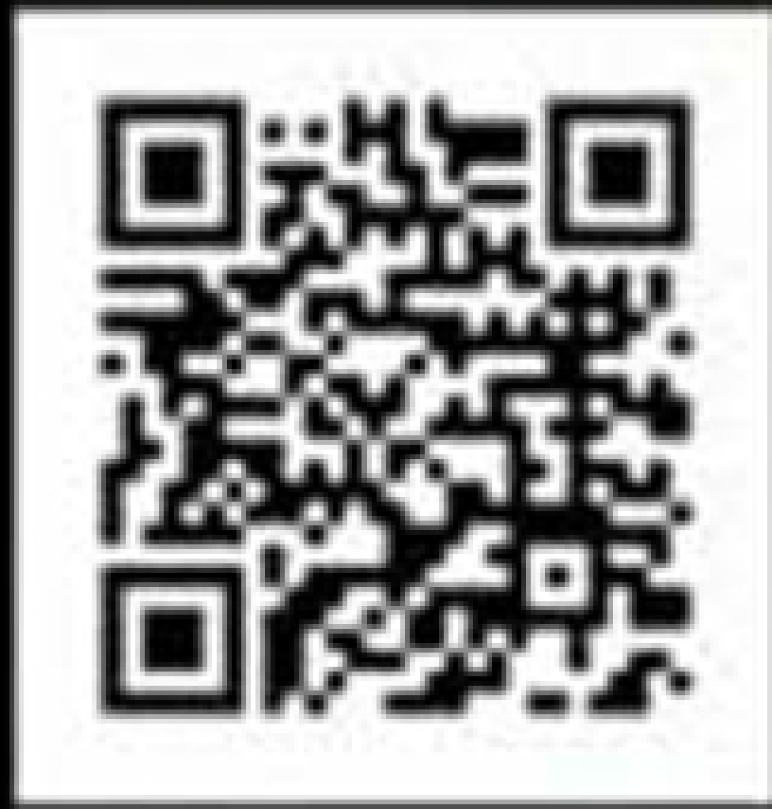
Registration details
Registration is open NOW!!
Deadline for registration is May 31, 2025 by 6am (before the start of the first swim meet).
Registration is online ONLY at:
www.canterberrycrocs.com

Slide 13
Frequently asked questions
My kid is very young, and I am not sure they can swim 25 meters unassisted. How do I find out?
Come to our first week of practice, and we will give them a ‘tryout’ so you know for sure.
We are considering joining the team but aren’t sure yet. Can we ‘try before we buy’?
Sure! Our first week of practice will be open to anyone that wants to try out the team. We think you will love it! The only cost is a non-refundable fee of $13 to cover insurance.
It’s summer, and we have plans that may/will result in us missing a meet or two. Is that OK?
No problem! That is the fun of summer swimming. We are very flexible to every family’s schedule.
It seems like there will be a lot of kids in the water. How safe is this?
We have Assistant and Junior Coaches who are in the pool with the kids at each practice.
Everyone on the coaching staff is Red Cross/CPR certified.
We have lifeguards hired for every practice.

Slide 14
